Slide 1
INDIAN RARE EARTHS LTD,KOLLAM
By
ARUN S MATHEW
M110321EE

Slide 2
IREL PROFILE
IREL is a Mining Industry under Atomic Energy of Energy, Govt of India.
God’s Own Country is blessed with long coastal belt. Kerala is endowed with heavy deposits of
. Ilmenite
. Rutile
. Zircon
. Monazite
. Sillimanite

Slide 3
Products and Specifications
Product | Specification | Specific Gravity | Bulk density (kg/m) | Major Application
1. Ilmenite | TiO₂-58% | 4.45-4.54 | 2600-2630 | TiO₂ pigment, Ti metal
2. Rutile | TiO₂-95% | 4.18-4.24 | 2630-2650 | Used as flux in welding electrode industry
3. Zircon | ZrO₂-65% | 4.60-40.7 | 2900-3000 | In ceramics refractories, foundries & glass industry
4. Sillimanite | Al₂O₃-58% | 3.2-3.25 | 1950-2050 | In refractory bricks, castable cordierites
5. Zirflor | ZrO₂-64% | ------------- | 1800-1850 | In refractory and foundry coating, opacifier in ceramic industry
6. Micro Zir | ZrO₂-63.5% | ------------- | --------------- | In ceramic glasses, heat resistant porcelain, refractories, plastics etc
7. Garnet | Abrasive for sand blasting water jet cutting & glass polishing
8. Monazite | Raw material for production of rare earth compounds

Slide 4
Magnetic and Electrostatic Properties of Sand components
Components | Magnetic Properties | Electrostatic Properties
Ilmenite | Magnetic | Conducting
Rutile | Non- magnetic | Conducting
Leucoxene | Weakly magnetic | Non conducting
Monazite | Weakly magnetic | Non conducting
Zircon | Non-magnetic | Non conducting
Sillimanite | Non-magnetic | Non conducting
Balance material | Non-magnetic | Non conducting

Slide 5
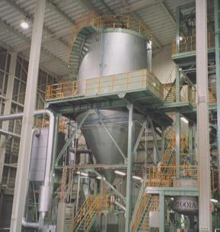
Fluidised Bed Dryer

Slide 6
Principle of operation

Slide 7
Advantages and Disadvantages
Uniform particle mixing
Uniform temperature gradients
Ability to operate reactor in continuous state
Disadvantages
. High Exhaust temperature
. As it is a single stage dryer, initial temperatures should be very.

Slide 8
Identifying Energy Conservation Opportunities
Ideal Drying curve of FBD
Drying curve of FBD at IREL

Slide 9
Calculation of SEC
Input Supply = 415V, 50 Hz
Total Amps = 66A
Total power consumed= $√3×415×66×0.8=37.95kW$
Total working hours = 2X3=6 hours
Energy consumption = 227.716 kWh
Feed rate = 100 kg/hr
SEC = 2.28 kWh/kg

Slide 10
Suggestion 1
Introduction to spray dryer

Slide 11
Adding Spray dryer as the first stage
Rating= 12.65W, 22 A
Feed rate = 50 kg/hr.
Assuming 70% increase in efficiency
SEC of FBD reduces to 1.58 kWh/kg
Energy consumption 158 kWh
Cost of Energy consumption before implementation of spray dryer= 228X30X6= Rs. 41,040
Cost of Energy consumption after implementation of spray dryer= 158X30X6= Rs. 28,440
Saving per month= Rs. 12,600/-
Initial investment= Rs. 5, 60,000/-
SPP= 3.5 years

Slide 12
Suggestion 2 Convection Recuperators
Flue type Recuperator
Typical Recuperator

Slide 13
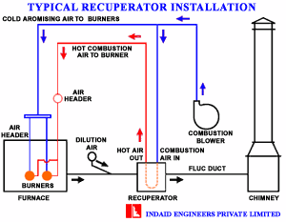
Working of Recuperator

Slide 14
Significance of Recuperator in IREL
Internal temperature = 200°C
Exhaust temperature =160°C
Calorific value of fuel oil = 43,000 kJ/kg
Cost of fuel oil = Rs. 30/kg
For drying 100 kg of slurry energy required = 100X2.09X175= 36,575 kJ
Fuel required for 100 kg = 0.85 kg
Cost of fuel oil =Rs. 25.50/-
Assuming efficiency of 40% and thereby increasing the temperature of primary gas from 25°C to 64°C
For drying 100 kg of slurry energy required = 100X2.09X136= 28,424 kJ
Fuel required for 100 kg = 0.66 kg
Cost of fuel oil =Rs. 19.83/-
SPP = 1.63 years

Slide 15
Thankyou

