Slide 1
INDUSTRIAL TRAINING AT BHEL EDN, BANGALORE
Section investigated: SOLAR PHOTOVOLTAIC SYSTEMS
FEMINA.P
M110430EE
IPA

Slide 2
BHEL – EDN : INDUSTRY PROFILE
Established in 1964
Largest manufacturer of power plant equipments in India
One among the Navaratna enterprises of the country
Has a share of 59 % in the total installed generation capacity of the country.
    Business areas:Power generation, transmission, transportation, defense, renewable energy, etc.

Slide 3
BHEL in Photovoltaics
  Over two decades experience in Semiconductors & Photovoltaics
  Over 15-MW of PV Systems supplied
  Technology developed in-house with mono-Silicon solar cells & PV modules up to 160-W_{p}
  PV system integration for various applications
  Certification by JRC, Ispra, Italy and Solar Energy Centre, MNES; ISO 9001, 14001 OHSAS 18001

Slide 4
Solar Photovoltaics-An introduction
Solar Photovoltaics has grown 23-times in a decade (1994-2004) and at the rate of 30% pa since 1990
Prospects of reaching 10-G-watt level by 2010 (0.7-G-watt in 2003)
Costs expected to come down with higher volumes (25% by 2010)
Increased market penetration through new applications
Well suited for distributed power generation

Slide 5
Principle of operation of solar cell
Photon
(E = hν)
Metal Contacts
R
n
Hole
Electron
E_{i}
p
Contact

Slide 6
Photovoltaic Efficiency Chart
(Commercial Level)
SINGLE CRYSTAL 15-17 %
POLY CRYSTAL 14-15 %
AMORPHOUS 6-8 %
THIN FILM (CIS/CdTe) 8-10 %
(Copper Indium di-Selenide/Cadmium Telluride)
THIN FILM (GaInP-GaAs-Ge) 26 %
(Space-quality solar cells)

Slide 7
Photovoltaic Power
-- Features
Clean, environment-friendly and renewable
Silent and non-polluting
Minimal maintenance
Only fuel required is sunlight
Modular
Generation of power at user point

Slide 8
Components of Photovoltaic Power
Solar Cells
    Convert sunlight into electricity
    Material Options : Silicon, Cadmium Telluride, Copper Indium diSelenide, (Gallium indium phosphide-Gallium Arsenide-Germanium).
Photovoltaic Modules
    Glass, Tedlar, Encapsulant, Aluminium Frame, Junction Box, Connector Cables
Balance of Systems
    Battery, Power Conditioning Unit, Mounting structure/Tracking device and Hardware

Slide 9
PROCESS FLOW CHART
Surface Texturing
Contact metalisation
Solar cell test
Lamination
Encapsulation
PV module test
PN junction doping
Junction isolation,passivation
Interconnections and layup

Slide 10
Textured Silicon Wafer Surface

Slide 11
Photovoltaic Power
-- APPLICATIONS
Stand-alone power plants
Grid-connected power plants
Street Lighting, Home Lighting systems
Water Pumping systems
Systems for Railway signaling, Telecom
Hybrid systems
Solar Lanterns

Slide 12
Photovoltaic Power Systems..

Slide 15
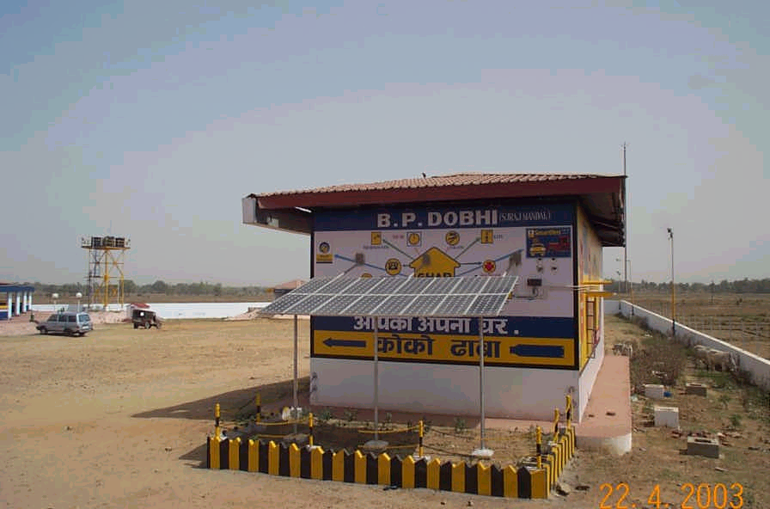
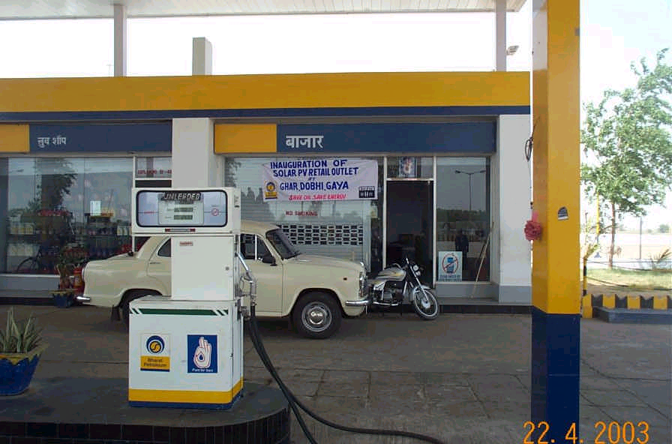
SPV-Diesel Hybrid System for Fuel Outlets
BPCL, Dobhi, Gaya

Slide 16
150-kWp SPV Power Plant, Kadamat

Slide 17
Mousini-II Solar PV Power Plant 110-kWp

Slide 18
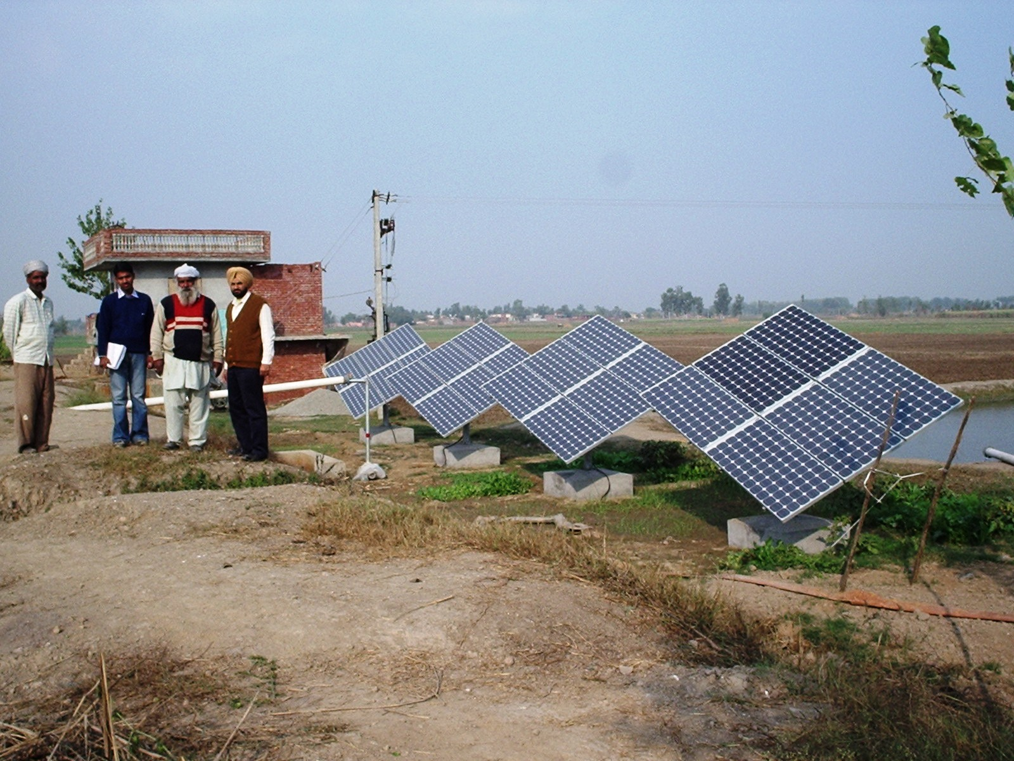
SOLAR WATER PUMPING SYSTEM

Slide 19
ENERGY ANALYSIS AND SUGGESTIONS
Comparative analysis of crystalline, poly crystalline and amorphous Silicon .
Comparing Solar Cell Materials
Solar cell material | Crystalline silicon | Polycrystalline silicon | Amorphous silicon
Embodied energy (kW-hrs/m²) | 553 | 407 | 116
Energy Conversion Efficiency (%) | 15-22 | 14-15 | 7-10

Slide 20
PAY BACK PERIOD CALCULATION

Slide 21
Calculation:
Net energy=3 kW-hrs
Pay back period:
Crystalline silicon:9 years
Poly crystalline silicon:10 years
Amorphous silicon:5 years
Suggestion 1:
Incorporate Amorphous silicon for the manufacturing process.

Slide 22
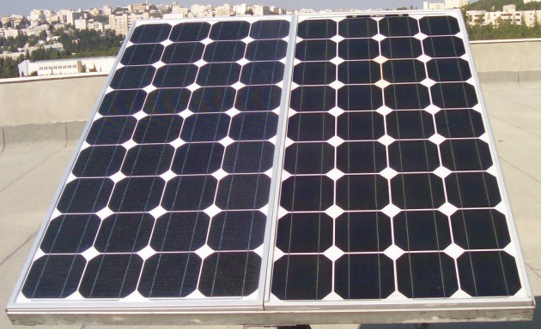
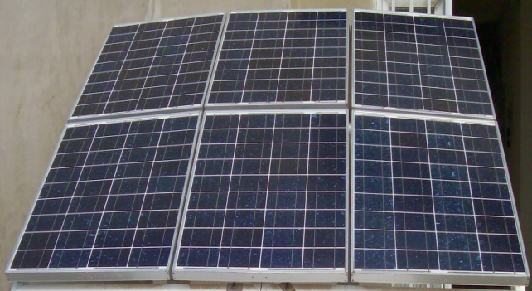
2.Comparitive analysis of monocrystalline and polycrystalline Silicon .
Monocrystalline Si
Poly crystalline Si

Slide 23
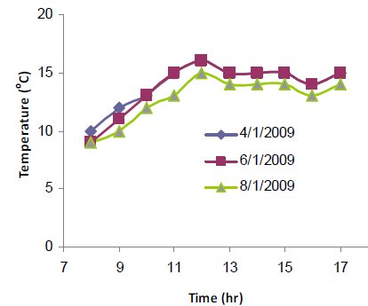
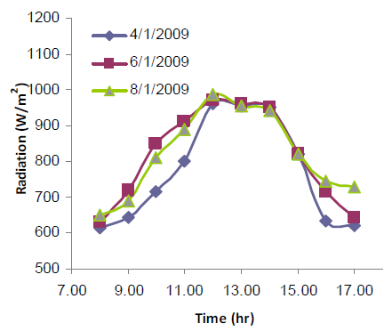
Experimental Results:

Slide 24
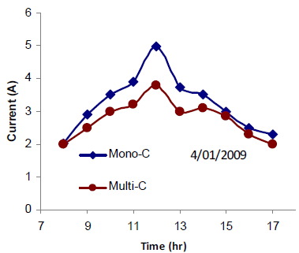
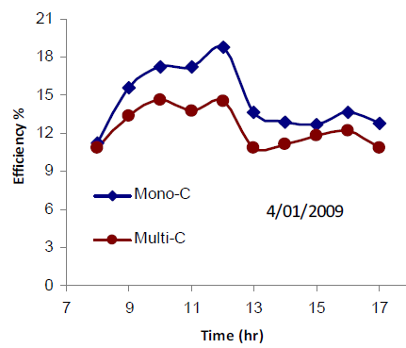
Suggestion 2:
Allow the major share of solar panels to be manufactured from mono-crystalline Silicon.

Slide 25
Suggestion 3: Use multi junction cells( Multiple layers of Si)
to capture light at different frequencies
Suggestion 4: Hybrid solar panels combining solar water heating and photovoltaics, so that the efficiency is not reduced on getting hotter.
Suggestion 5: Building integrated solar panels instead of fixed ones.
Suggestion 6: Use LASER doping for diffusion of emitters.
Suggestion 7: Complete automation of the whole manufacturing process.

Slide 26
CONCLUSION:
The industrial visit to BHEL gave a clear insight into the manufacturing, testing and distribution process of solar PV
The section was analyzed in detail and the gaps were identified
Calculations were performed from literature to analyze the energy flow.
Suggestions were given to improve the efficiency of solar panels

Slide 27
REFERENCES
WEBSITES
  www.bheledn.com
  www.bhel.com
  http://www.scribd.com/doc/60962643/Summer-Training-Report-BHEL-1-ASHWIN-AGGARWAL-Repaired
PUBLICATIONS
  Joshua Pearce and Andrew Lau “Net Energy Analysis For Sustainable Energy Production From Silicon Based Solar Cells”- Technology and Society Program College of Engineering, The Pennsylvania State University.
  M. R. Abdelkader a, A. Al-Salaymeh a, Z. Al-Hamamre b, Firas Sharaf c “A comparative Analysis of the Performance of Monocrystalline and Multiycrystalline PV Cells in Semi Arid Climate Conditions.”

