Slide 1
Industrial Training at CSIR –NAL
Radhika N.K. M110413EE

Slide 2
Company profile
National Aerospace Laboratory (NAL)
- premiere research institute under CSIR
Established : 1959
Headquarters: Bangalore
Mission:
-Development of national strengths in aerospace sciences and technologies, infrastructure, facilities and expertise
-Advanced technology solutions to national aerospace programmes.
-Civil aeronautics development
Logo

Slide 3
Facilities visited
Industrial Fibre Research Facility (IFRF)
Flight Mechanics and Control Division (FMCD)
Aerospace Electronics and Systems Division (AESD)
Advanced Composites Division (ACD)
Electrical Division

Slide 4
IFRF
Indigenous technology for manufacturing carbon fibre
Pilot plant with capacity 20 TPA.
Technology transferred to Kemrock Industries and Exports Ltd. (KIEL) in 2010
India’s first and only commercial carbon fibre manufacturing plant with 350 TPA capacity by KIEL
Current focus:
Higher modulus carbon fibre for space applications.

Slide 5
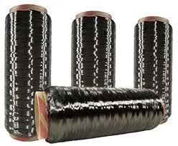
Carbon fibre
Fibres 5-10µm in diameter made mostly of carbon atoms
High tensile strength
High modulus
Low density
Reasonable cost
high chemical resistance
high temperature tolerance
low thermal expansion

Slide 6
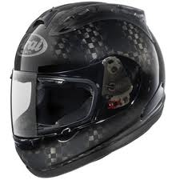
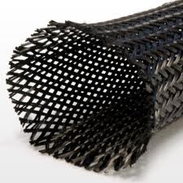
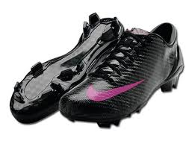
Uses of Carbon fibre

Slide 7
The Process
Polymerization section
Acrylonitrile +co monomers → Polyacrylonitrile (PAN)
Spinning section
PAN stretched and spun into fibres
Heat treatment section
PAN→ carbon fibre

Slide 8
Polymerization section
Acrylonitrile + comonomer
CSTR
Monomer stripping
Centrifuge feed tank
Rotary Vaccum Paddle dryer
Dry powder

Slide 9
Polymerization reaction in CSTR

Slide 10
Spinning section
Dry polymer
Granulator
Spin dope (60-65ºC)
Spinnerette
Coagulation bath(30ºC)
Rollers (stretching)
Drying and winding(135ºC)

Slide 11
Heat treatment section
PAN precursor
Stabilization
Graphitization
Surface treatment
Sizing bath
Carbon fibre

Slide 12
Stabilization
Oxidation in multizone oven
220ºC - 300ºC
Line speed 40-50m/h
Product :PANOX
PANOX –fire resistant material
Roller speeds controlled by AC drives
Carbonization
L T furnace
Filled with nitrogen
6 temperature zones
300ºC - 900ºC gradually
Heating element Kanthal
PID control for temperature

Slide 13
High temperature processing
As temperature increases, modulus increases
Strength maximum at 1500ºC
2 individually controlled zones with graphite elements situated above
Furnace filled with nitrogen
Cooling jackets near bus bars and power feeders (50ºC)

Slide 14
Surface treatment
3 electrolytic treatment cells
2 wash cells
Oil heated drying rollers
Sizing bath
immersion in bath of 0.5% epoxy resin

Slide 15
Plant Control
DCS
ABB Freelance 2000 series
1000 inputs
AF800 series controllers are used
Protocols
Operator, Process and Engineering stations linked by Ethernet.
CPU modules and I/O modules linked by CAN
Modbus links certain subsystems via RS485 interface

Slide 16
Control builder F is the software used for configuration of DCS.
Controller tuning done mostly on trial and error basis. No comprehensive tuning strategy executed as yet.

Slide 17
Energy saving measures
Electric power
APFC panel of 360 kVAR installed. Pf close to unity
Thermal power
3TPH boiler used for process steam at 7 kg/cm²
Demineralized water used to prevent scaling
Economizer used to transfer heat from flu gas to feed water.

Slide 18
Proposals
Implement Model predictive control as tuning strategy
Bottoming cycle Cogeneration scheme
Hindrances:
Intermittent nature of plant operation
Toxic nature of flue gases
Research facility

Slide 19
Thank you

