Slide 1
PRESENTATION ON INDUSTRIAL TRAINING
By
Sajin Gopi
M110123EE
IPA,EED,NITC

Slide 2
INDEX
COMPANY PROFILE
COMPANY PRODUCT
INTRODUCTION
CONTROL

Slide 3
COMPANY PROFILE

Slide 4
INDIAN OIL CORPORATION
GUJARAT REFINERY
.P.O. JAWAHARNAGAR,
BAJUWA,
DIST. VADODARA,
GUJARAT 391320.
WEBSITE : www.iocl.com

Slide 5
COMPANY PRODUCTS
L.P.G.
BENZENE
TOLUENE
NAPTHA
MOTOR SPIRIT [87 OCTANE]
MOTOR SPIRIT [93 OCTANE]
AVIATION TURBINE FUEL
SUPERIOR TURBINE FUEL
HIGH SPEED DIESEL

Slide 6
PRODUCTS
LIGHT DIESEL OIL
LOW SULPHER HEAVY STOCK
FUEL OIL
BITUMEN.
N -NEPTHENE.
ALUMNIUM ROLLING.

Slide 7
INTRODUCTION

Slide 8
GUJARAT REFINERY
“ ISO 14001 -A GLOBAL PERSPECTIVE”

Slide 9
REFINERIES
The Digboi Refinery (Assam)
Guwahati Refinery (Assam) -first public sector refinery
Barauni Refinery (Bihar)
Haldia Refinery (Bengal)
Mathura Refinery(UP)
Panipat Refinery (Haryana)
Bongaigaon Refinery (Assam)

Slide 10
GUJARAT REFINERY
THIS IS THE LARGEST REFINERY IN WESTERN INDIA. IT WAS COMMISSIONED IN 1965.
THE PRODUCTS PRODUCED BY THE REFINERY IS TO SERVES TO DEMAND FOR PETROLEUM PRODUCTS IN WESTERN & NORTHERN INDIA.
THE CRUDE OIL FOR THE REFINERY IS DIRECTLY COMING FROM THE BOMBAY HIGH BY PIPELINE

Slide 11
Cont.
crude processing capacity of 18 million metric tonnes per annum
petrochemical products Linear Alkyl Benzene (LAB), Polypropylene Feed Stock & Polymer Grade Hexane.

Slide 12
PROCESS
Five Atmospheric Units (ADUs)
gasoline, naphtha, kerosene and gas oil
Vacuum distillation Unit
preheated, atmospheric tower
Catalytic Reforming Unit
zeolite based catalyst
higher molecular weight component in to light molecules including LPG, gasoline, diesel
Fluidized Catalytic Cracking Unit
Hydro-cracking Unit

Slide 13
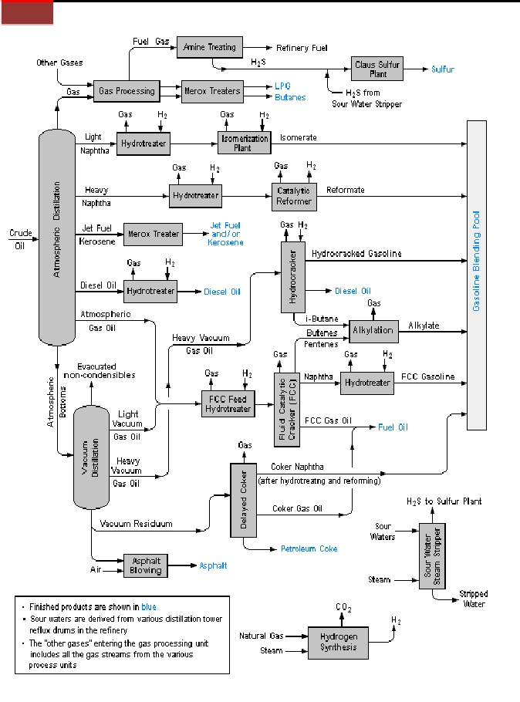
REFINERY LAYOUT

Slide 14
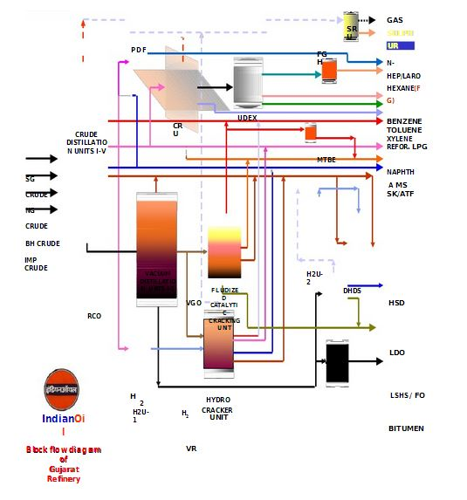
PRODUCTS DIAGRAM

Slide 15
CONTROL REQUIREMENT
Distribution of control system across the plant.
Integration of complete plant data with the other plants & management information system.
Involves high speed networks for data transmission at various levels.
System expandability & flexibility.
Redundancy at various levels.

Slide 16
DCS & PLC SYSTEMS
DCS MONITORING
CONTROL
ALARM
PLC SHUT DOWN
INTERLOCKING
SEQUENCING OF PROCESS PLANTS
(200ms Scanning Time)

Slide 17
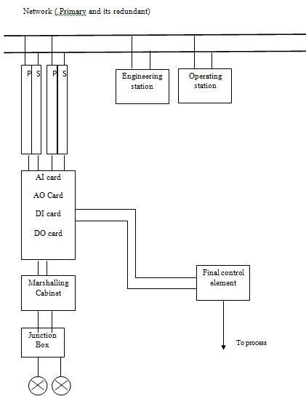
DCS MODEL

Slide 18
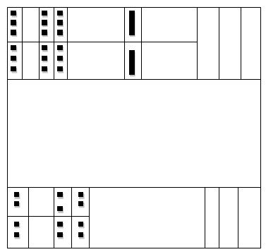
ABB SYSTEM CABINET(DCS)
PM510 //PROCESSOR( WITH ITS REDUNDANT)
PM510
SC510 //CARRIER TO DNS (NETWORK)
SC510
CI540 // LAN NETWORK (to communicate with other DCS)
CI540

Slide 19
ABB SYSTEM CABINET(PLC)
PAC //POWER SUPPLY
PAC
MAI32NAD //ANALOG INPUT MODULE
MAI32NAD
MSROX 1 //TRANSMISSION TO ENGINEER
STATION AND LOGGER
MSROX 1
MPP //PROCESSOR (TRIPLE MODULAR
REDUCTANT)
MPP
MPP

Slide 20
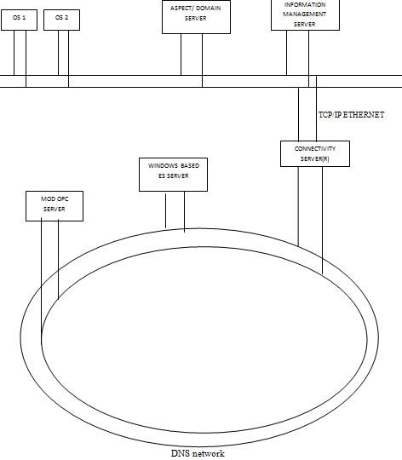
DCS FOR DHDS

Slide 21
CONTROL STATIONS
DCS
OPERATING ENGINEERING
STATION STATION
MONITORING
ALARM
BASIC CONTROL
CONTROL
TUNING

Slide 22
TDC 300 DCS SYSTEM
The TATA-Honeywell make TDC 3000 distributed control system is a congregation of the a number of
devices :-COMMUNICATION NETWORKS, CONTROLLERS, OPERATOR STATIONS, GATEWAYS etc..
As a result of its distributed nature ,the system offers incremental capacity, incremental functions and incremental redundancy

Slide 23
TDC-3000 ARCHITECTURE
The Networks:-
In TDC 3000 there are three principle networks :-
Local Area network
The universal control network
Data Hi-way
The Local Area Network connects the control Room Modules, while the universal control network and and Data Hiway link the process connected devices.

Slide 24
TDC-3000 ARCHITECTURE
Gateways and Interface modules:-
Hi-way gateway (HM)
Network Interface module NIM)
Programmable logic controller gateway (PLCG)
Data Highway port (DHP)
Computer gateway (CG)
Gateway and interface modules connect process communications networks and computers to the system’s principal communications network

Slide 25
TDC-3000 ARCHITECTURE
Process modules:-
There are discrete Process modules performing specific functions such as advance control, history collection and computing:-
Multifunction controller (MC)
Advanced multifunction controller (AMC)
Advanced process manager (APM)
Application module (AM)
History module (HM)

Slide 26
TDC-3000 ARCHITECTURE
Man-Machine interface:-
UNIVERASAL STATIONS grouped into one or more operator consoles. They are used to :-
Used to monitor and manipulate the process.
Annunciate and handle process & system alarms.
Display & print process History, process Trends & process Averages.
Build system & process database, graphics displays & reports
Diagnose problem in any module in the system

Slide 27
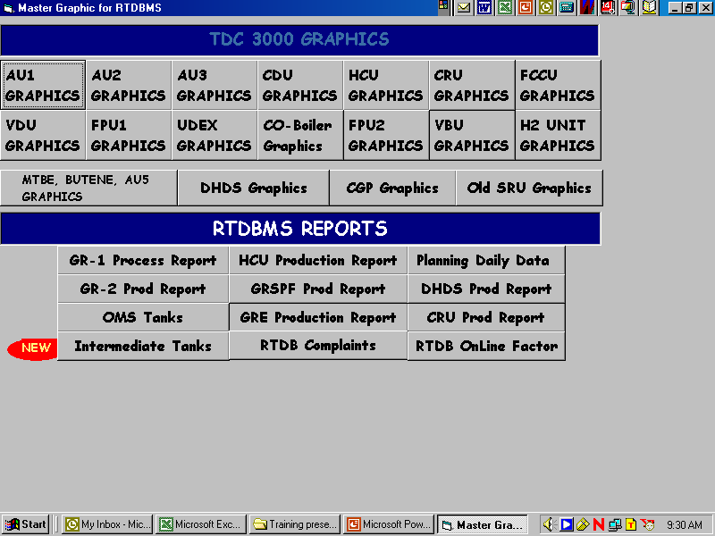
OPERATING STATION

Slide 28
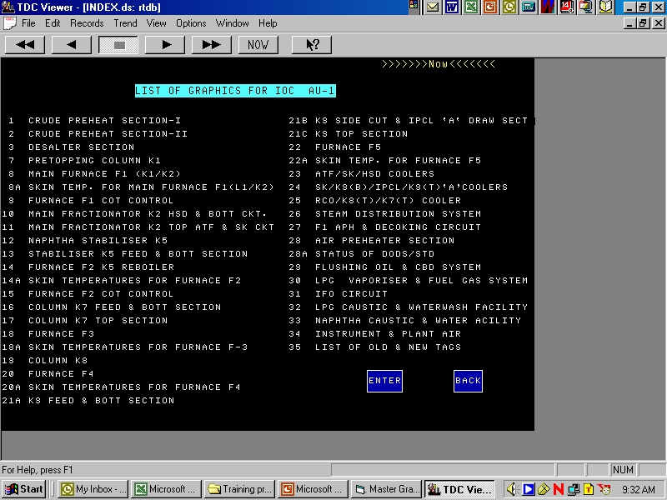
OPERATING STATION

Slide 29
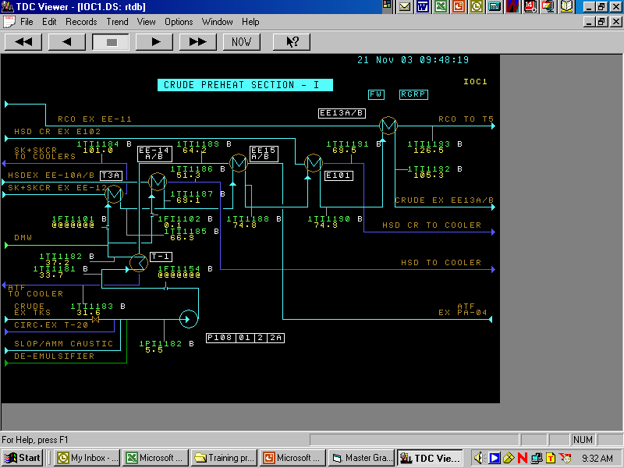
OPERATING STATION

Slide 30
LOCAL CONTROL NETWORK
COMPUTING MODULE
APPLICATION
MODULE
HISTORY
MODULE
COMPUTER
GATEWAY
UNIVERSAL
STATION
LOCAL CONTROL NETWORK
LCN
EXTENDER
FIBER OPTICS
HIGHWAY
GATEWAY
NETWORK
INTERFACE
MODULE

Slide 31
DATA HIGHWAY
LOCAL CONTROL NETWORK
HIGHWAY
GATEWAY
D
A
T
A
H
I
G
H
W
A
Y
ADVANCED MULTI-
FUNCTION COMPUTER
DATA HIGHWAY PORT
PROCESS INTERFACE
UNITS
PERSONAL COMPUTER
SERIAL INTERFACE
BASIC CONTROLLER
CRITICAL PROCESS
CONTROLLER
MULTIFUNCTION
EXTENDED
CONTROLLER
HONEYWELL
PROGRAMABLE
CONTROLLER

Slide 32
UNIVERSAL CONTROL NETWORK
LOCAL CONTROL NETWORK
NETWORK
INTERFACE
MODULE
PROCESS MANAGER
ADVANCED PROCESS
MANAGER
UNIVERSAL CONTROL NETWORK
LOGIC MANAGER
HIGH PERFORMANCE
MODULE

Slide 33
SYSTEM ARCHITECHTURE
C.G.
A.M.
H.M.
U.S.
LOCAL CONTROL NETWORK
H.G.
N.I.M.
UNIVERSAL CONTROL NETWORK
A.M.C.
A.P.M.
D.H.P.
L.M.
DATA HIGHWAY
C.P.C.
H.P.M.

Slide 34
RECOMMANDATION
CONTROLLERS – LOW COMPUTATION TIME
SAFTEY CONTROLLERS
ADVANCED CONTROL STRATEGIES

Slide 35
THANK YOU

