Slide 1
GMTCI
By
Tanushree Dalai
M110260EE
NITC,IPA

Slide 2
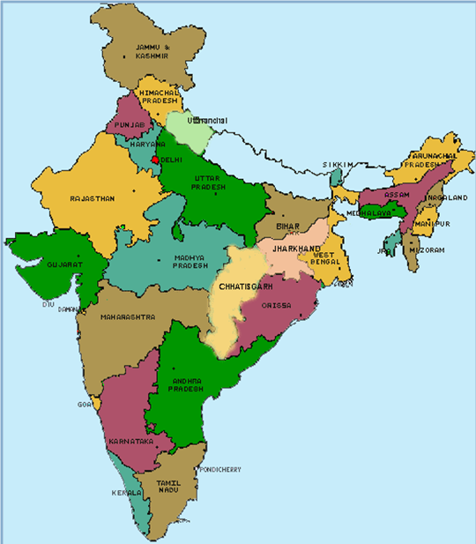
GM IN INDIA
Corporate Office
Delhi
Halol Plant
Talegaon (Pune) Plant
GM Tech Centre Bangalore

Slide 3
GM PRODUCTS IN INDIA
SAIL-UVA
BEAT
CAPTIVA
SPARK
CRUZE
AVEO

Slide 4
GMTCI-ORG STRUCTURE
PT
VE
ME
Functional
R&D
Design
SFO
FSSC
AC Delco
HR
Finance
Operations
Legal
IT
WFG
Located in Bangalore, India >300,000 Sq. ft. In International Technology Park Limited (ITPL)

Slide 5
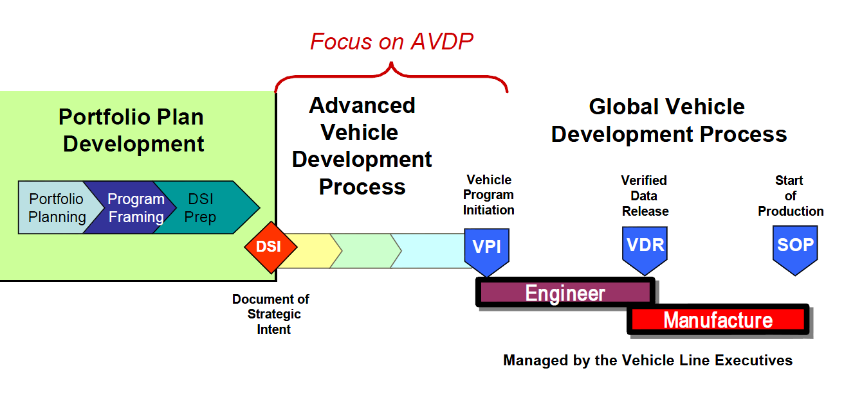
VEHICLE DEVELOPMENT PROCESS

Slide 6
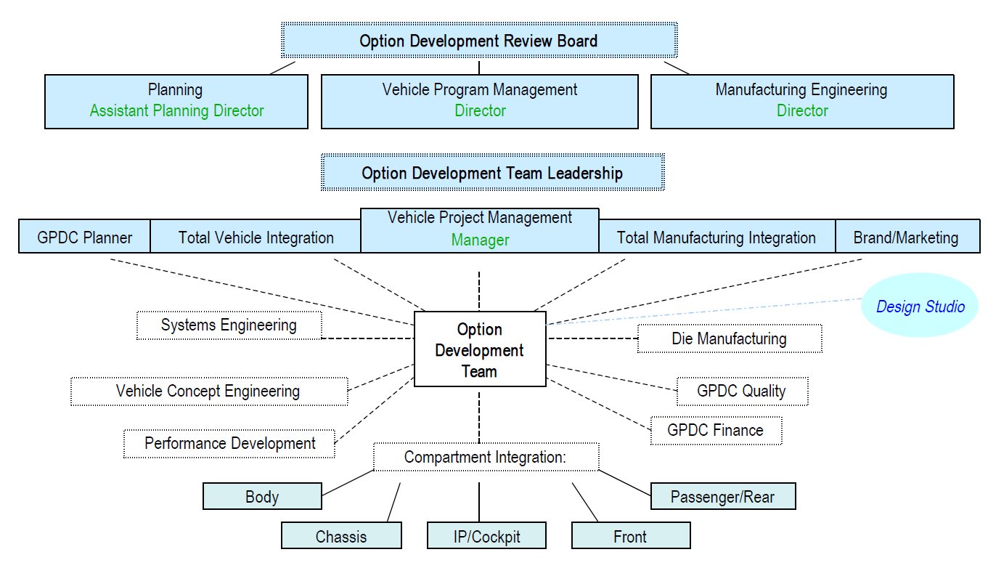
TEAM STRUCTURE

Slide 7
VEHICLE ENGINEERING
Pre-VPI vehicle development
Studio Engineering and Compartment Integration activities on local programs.
Studio engineering support for global Garnish & Trim programs.
Benchmarking of competitor vehicles in the Indian market
Innovation Zone
Advanced Vehicle Quality

Slide 8
POWERTRAIN ENGINERING
designs, engineers and manufactures engines, transmissions, castings, and components for GM vehicles and other automotive, marine and industrial original equipment manufacturers.
operating and coordinating responsibility for GM's powertrain manufacturing plants and engineering centers in North and South America, Europe and the Asia-Pacific region

Slide 9
E-ASSIST POWERTRAIN
Automatic engine start-stop functionality that uses electricity instead of gasoline when stopped
Aggressive fuel cut-off during deceleration down to zero mph for added fuel savings
Regenerative braking, which provides up to 15 kW of electricity to charge the lithium-ion battery

Slide 10
ELECTRICAL SYSTEMS, CONTROLS & SOFTWARE ENGINEERING
For Global-A Electrical Architecture
Development, Testing & Deployment of Product Software
Electrical Controls Engineering Process Improvement.
De-coupled Development

Slide 11
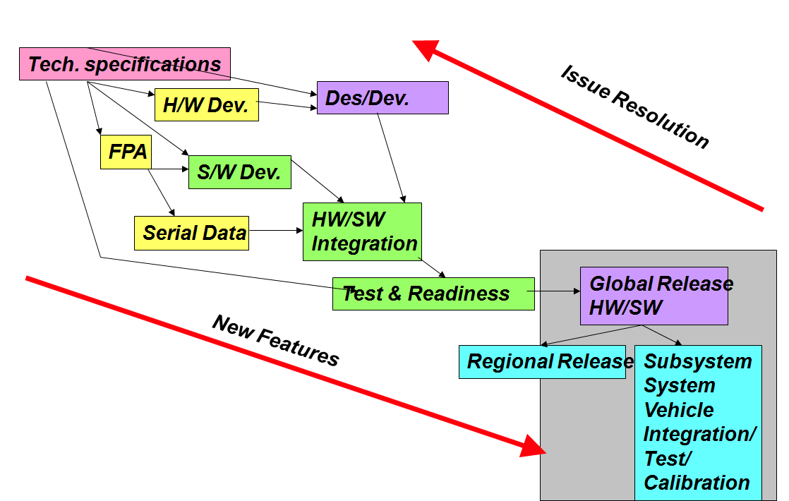
WORKFLOW

Slide 12
ENGINE CONTROL UNIT
Working
Control of Air/Fuel ratio
Control of ignition timing
Control of idle speed
Control of variable valve timing
Electronic valve control

Slide 13
ECU SCHEMATIC

Slide 14
INSTRUMENT CLUSTER
Gathers and displays data from various parts of the vehicle.
updates the appropriate gauge or indicator with the new value.

Slide 15
BODY CONTROL MODULE
Responsible for monitoring and controlling various electronic accessories
Controls the power windows, power mirrors, air conditioning, immobilizer system system, central locking…
Its main application is controlling load drivers – actuating relays

Slide 16
SCHEMATIC OF BCM

Slide 17
SENSING & DIAGNOSTIC MODULE
Detects accelerations
Makes split-second decisions for deployment (of airbags) and non-deployment events
Tracks data on pre-deployment braking; engine speed; vehicle speed; percent throttle; seat belt use; and also records crash data. This can be retrieved from the event data recorder (EDR)

Slide 18
TRANSMISSION CONTROL MODULE
Input parameters-
Vehicle speed sensor (VSS)
Wheel speed sensor (WSS)
Throttle position sensor(TPS)
Turbine speed sensor (TSS)
Transmission fluid Temperature sensor (TFT)
Kick down switch
Brake light switch
Traction Control System (TCS)
Cruise control module
Inputs from other controllers

Slide 19
TRANSMISSION CONTROL MODULE
Output parameters
Shift lock
Shift solenoids
Pressure control solenoids
Torque converter clutch solenoid (TCC)

Slide 20
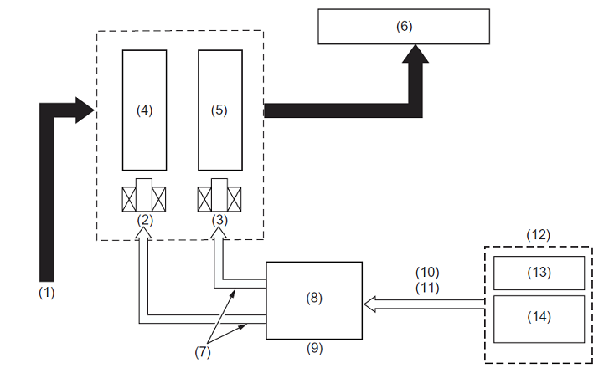
TCM CONTROL
(1) ATF
(2) Solenoid 1
(3) Solenoid 2
(4) Shift valve A
(5) Shift valve B
(6) Shift clutch
(7) Shift command signal
(8) TCM
(9) Determination of opt gear
(10) Throttle opening
(11) Vehicle speed
(12) Sensor
(13) Vehicle speed sensor
(14) Throttle position sensor

Slide 21
CONCLUSION
Exposure to industry
Basic knowledge on automobile working
Present scenario and future requirements in automobile sector

Slide 22
REFERENCE
http://www.archivedsites.com
W1860BE.book
http://www.archivedsites.com/techlink
http://www.mne.psu.edu/simpson/courses/me546/lectures/me579.Cafeo.GM.slides.pdf

