Slide 1
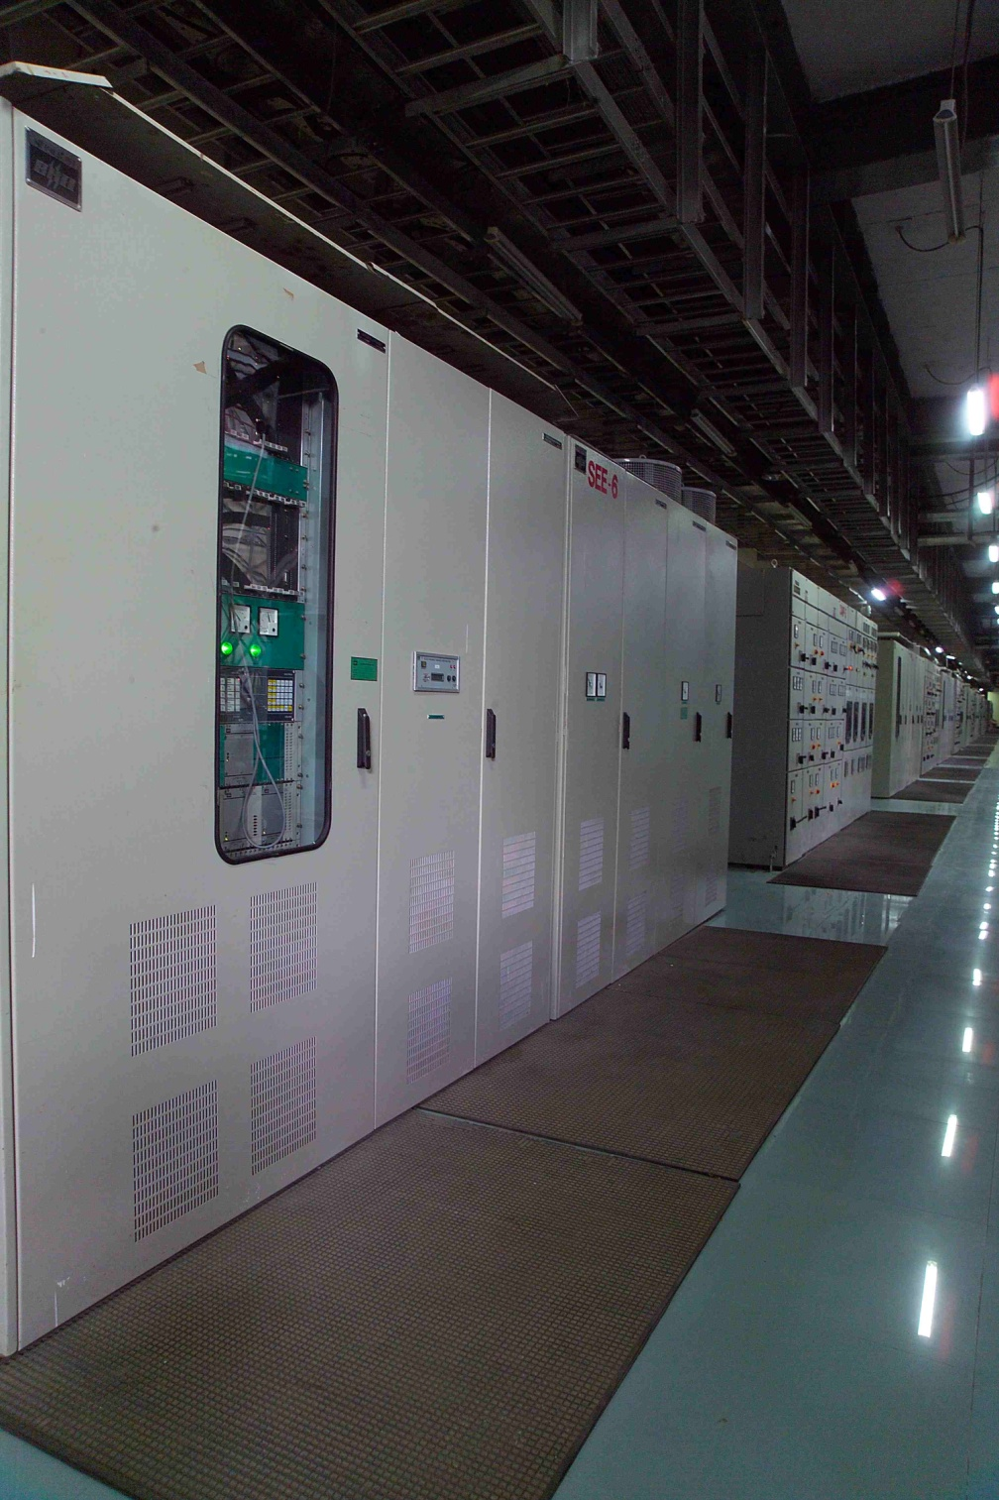
DIGITAL EXCITATION SYSTEM
Bharat Heavy Electrical Limited (Electronics Division), Bangalore
By,
Zaher V. Abdul Rahaman

Slide 2
Bharat Heavy Electricals Limited (BHEL)
BHEL is the largest engineering and manufacturing enterprise in India
Established in 1964.
The firm is engaged in the design, engineering, manufacture, construction, testing, commissioning and servicing of a wide range of products and services for the core sectors of the economy, viz. Power, Transmission, Industry, Transportation(Railway), Renewable Energy, Oil & Gas and Defence.

Slide 3
VISION
A world-class engineering enterprise committed to enhancing stakeholder value.
MISSION
To be an Indian multinational engineering enterprise providing total business solution through quality products, systems and services in the fields of energy, industry, transportation, infrastructure and other potential areas.

Slide 4
PURPOSE OF EXCITATION SYSTEM
REGULATE TERMINAL VOLTAGE OF THE MACHINE.
MEET EXCITATION POWER REQMTS UNDER ALL NORMAL OPERATING CONDITIONS.
ENABLE MAXIMUM UTILISATION OF MACHINE CAPABILITY.
GUARD THE MACHINE AGAINST INADVERTANT TRIPPING DURING TRANSIENTS.
IMPROVE DYNAMIC & TRNSIENT STABILITY THEREBY INCREASING AVAILABILITY.

Slide 5
PERFORMANCE SPECIFICATION OF EXCITATION SYSTEM
ACCURACY OF VOLT. REGLN. : +/- 0. 5 %
RANGE OF AUTO CONTROL : 90 TO 110 % OF UGN
RANGE OF MANL CONTROL :75 %NL TO 110 % FL If
RANGE OF DROOP/DROP COMPSN : 0 TO 15 %
FREQ. RANGE OF OPERATION : 47 TO 52 HZ
FIELD FORCING FACTOR : 1.6 TO 2.0
FIELD FORCING TIME : MAX 10 SECONDS
RESPONSE RATIO & TIME : 3 TO 4 & < 20 mSEC
VOLT.RISE ON FL THROW-OFF : < 15 %
CHANGE OF GEN. VOLT : <= +/- 1 %
WITH CHL. CHANGE OVER

Slide 6
TYPES OF EXCITATION SYSTEM: 1.INDIRECT EXCITATION (BRUSHLESS EXCITATION) 2.DIRECT EXCITATION (STATIC EXCITATION)
INDIRECT EXCITATION (Brushless Excitation)
APPLICATION IN SYN MACHINE (THERMAL/GAS)
EXCITATION POWER TO EXCITER FIELD WINDING
THE EXCITER ARMATURE RECTIFIED OUTPUT TO MAIN FIELD WINDING ( ON THE ROTOR)
ROTATING DIODES MOUNTED ON THE ROTOR
INPUT POWER TO EXCITATION FROM PMG/AUX SUPPLY

Slide 7
COMPARISON
BRUSHLESS SYSTEM
RESPONSE LIMITED TO EXCITER M/C TIME CONST.
FIELD DISCHARGE WITH NATURAL TIME CONSTANT
SUPPLY FROM PMG & NO INITIAL BUILD-UP CIRCUIT REQD
STATIC EXCITATION
FAST RESPONSE
FAST FIELD DISCHARGE BY RESISTOR & INVERTER OPERATION
INITIAL BUILD-UP CIRCUIT IS REQD

Slide 8
COMPARISON (CONTD.)
BRUSHLESS SYSTEM
EASY SUPPORTING OF SHORT CKT IN SMALL INDUSTRIAL M/CS
NO SLIP RINGS & BRUSHGEAR. DIRECT MEASUREMENT OF FIELD PARAMETERS NOT POSSIBLE
LESS POWER REQMTS SMALL THYRISTOR RECTIFIERS
LESS SPACE REQUIRED
STATIC EXCITATION
SUPPORTING OF SHORT CKT CURRENT NEEDS COMPOUNDING TRAFO.
DIRECT MEASUREMENT OF FIELD QUANTITIES UF & IF POSSIBLE
MORE POWER REQMTS NO LIMITATION ON REDUNDANCY OF THYRISTOR BRIDGE
MORE SPACE REQUIRED

Slide 9
ADVANTAGES OF STATIC EXCITATION EQUIPMENT
REDUNDANCIES INCREASE RELIABILITY AND AVAILABILITY.
MONITORING AND DIAGNOSTICS REDUCES DOWN TIME.
ABSENCE OF ROTATING PARTS ENABLE MAINTENANCE WITH EASE EVEN WHEN THE EQPT IS IN SERVICE.
UPRATING OF THE M/C BY USING UP THE MARGINS
OR BY ADDING ADDITIONAL CIRCUITS.
EASE OF EQUIPMENT LAYOUT.
BETTER OPTIONS FOR PLANT R&M.

Slide 10
DIRECT OR SHUNT SUPPLIED STATIC EXCITATION SYSTEMS
APPLICATION IN SYN. M/C (HYDRO/THERMAL/GAS ETC)
EXCITATION POWER FROM GENERATOR TERMINALS
EXCITATION TRAFO FEEDS THE THYRISTOR RECTIFIER
RECTIFIED OUTPUT APPLIED TO THE M/C FIELD COILS
FIELD CKT. BREAKER FOR ISOLATION & DISCHARGE

Slide 11
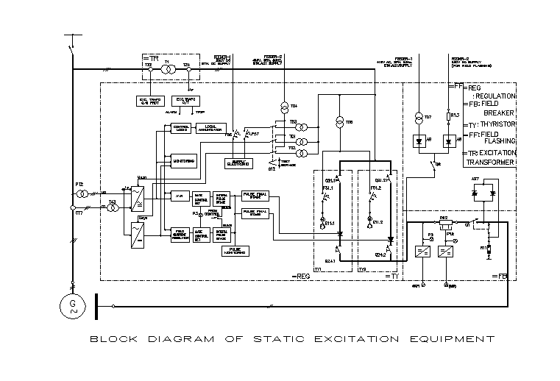

Slide 12
Thank You

